Slide 1
Master Thesis warm up
Zoltan Mark Pinter, s172040
Supervisor for special course: Dimitrios Papageorgiou <dimpa@elektro.dtu.dk>

Slide 2
Schedule
Introduction to the project that I have done with Dimitrios.
Introduction to the motivation of Lars for the master thesis.
Finding a correct date to start, so that the finishing time will be convenient for all three of us.

Slide 3
Notation
h – enthalpy
p – pressure
Q – heat flow
d or rho – density
T – temperature
Dot(m) – mass flow
V volume (constant)
Dot(V) – volume flow
M – mass (constant)
f_1 – friction coefficient
l – length of tube
d – inner diameter of tube (in the tube resistance equation)
Eta: efficiency

Slide 4
Models
Model in Dymola - TIL Suite (Modelica object oriented prog. lang.)
Solved by implicit solvers with DAE (DASSL)
-> bad initialization, speeds up after the nonreliable transients
Matlab model: classdef used for object oriented script based programming
Ode15s is used to solve: explicit
More reliable initial transient, very slow
Fluid dynamics considered more, advanced heat transfer less
Conclusion: matlab model is used for initial model check for controller design, but experiments shall be done on the Modelica model
Current control: distributed PI controllers

Slide 5
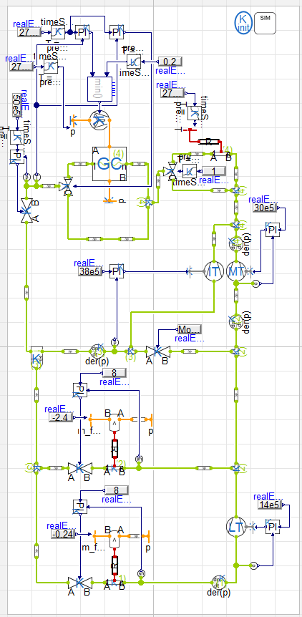
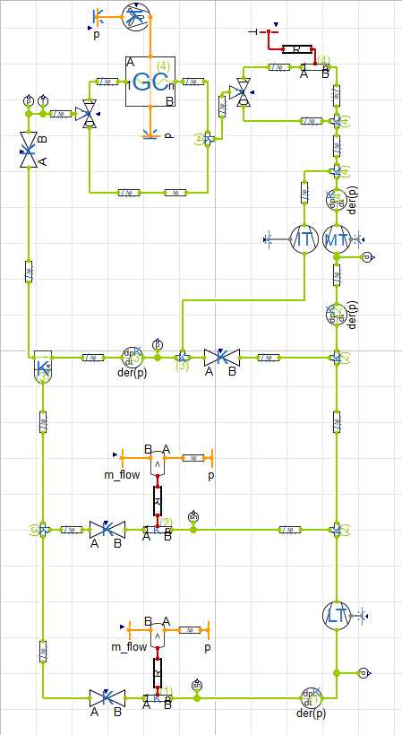
Modelica model (confidential)
Gas Cooler considered in a several volume cell model, the rest of the elements are concentrated

Slide 6
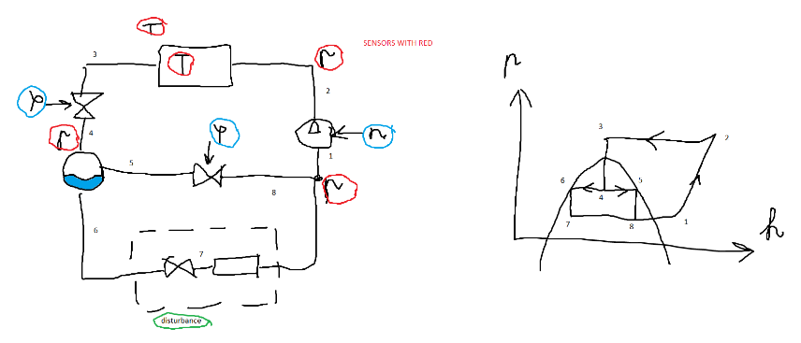
Matlab Model
Actuators: compressors, valves, fans
Gascooler (condenser) with volume cells
Evaporators, receiver
1 step version is in the figure (but we consider cooler and freezer separately)
Supercritical operation considered
Cooler volume is currently modelled (not the heat transfer dynamics)
Disturbance as programmed boundary condition

Slide 7
Dynamics
Volume equations
Differentials from ph diagram are connected by partial differentials, pressure can be determined
Mass balance determines density
Energy balance determines enthalpy
Flow resistances
Resistance model in gas cooler
Valves as adjustable resistances (actuators)
Volume flow generator: compressor
Static equations (constraints)
Enthalpies for valves and compressors
Receiver: separation of liquid and gas
Joints: energy and mass balance with no accumulation
Most nonlinear part: ph reading (non-smooth under saturation curve)
CoolProp is used for that (partial derivatives, temperature, entropy, etc)
Heat transfer equations (static -> adjustable boundary condition)
Both (serially connected) thermal resistances are influenced by fan speed
Convection and air energy balance
Air temperatures are determined from them
Boundary conditions (disturbances)
Ambient air temperature
Heat flow into cooler and freezer cabinets

Slide 8
Object oriented programming
Every component is an object
Connect object is used to create connection constraints
-> modularity
Equations are solved together
First constraints, then dynamic equations are evaluated in loops, separately
Constraints are to be set in the right order to avoid discrepancies (can lead to an unnecessary stiff system)

Slide 9
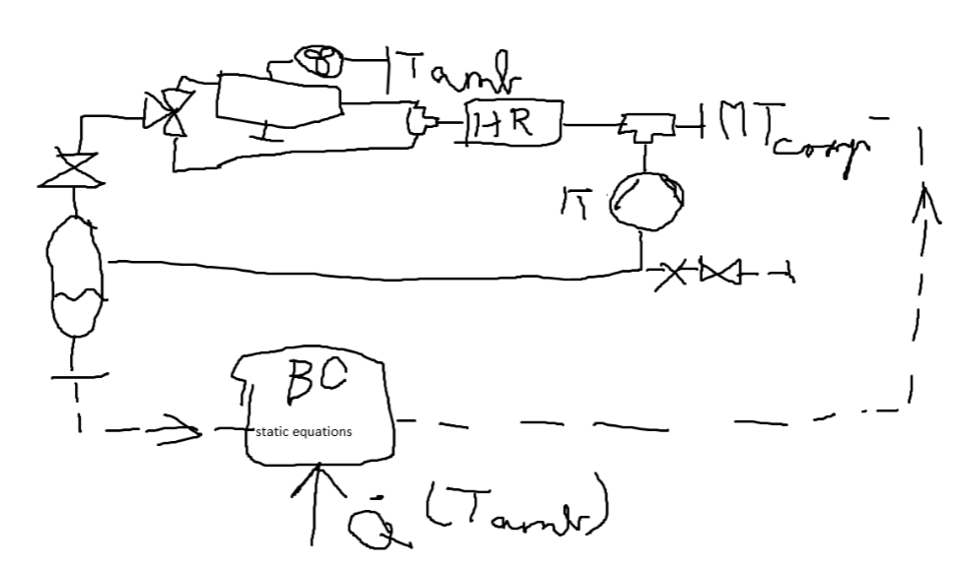
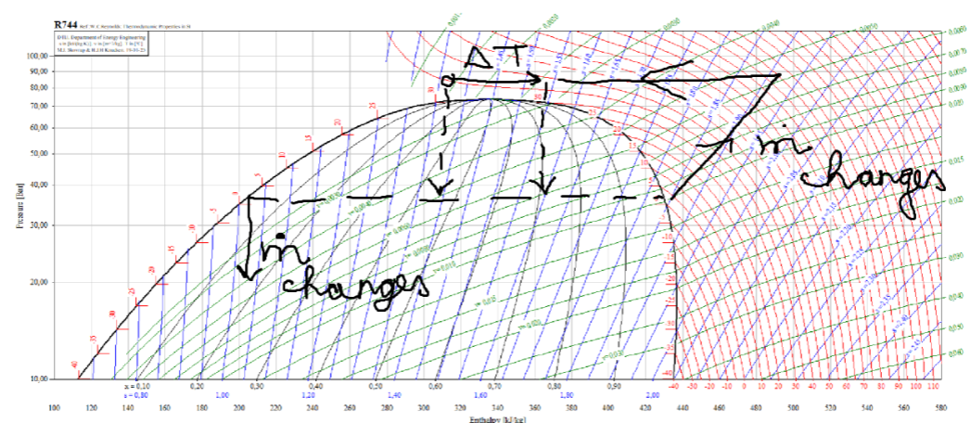
Master Thesis (motivation of Lars)
Gas Loop
Deviation or hysteresis in temperature measurement
-> Fluid heats up and loses heat gaining capacity
-> Hot gas is circulated, while cabinets warm up
Model for thesis: heat recovery and bypass valve added, cooler volume excluded
-> reducing model uncertainty
Only for control purposes
Current solution: increasing pressure temporarily
Possible tasks:
Identification of highly nonlinear parameters
Estimation for control
Control in a feasible way (with early detection, or robust control?)

Slide 10
Thank you for your time and see you on Friday!

